Slide 1

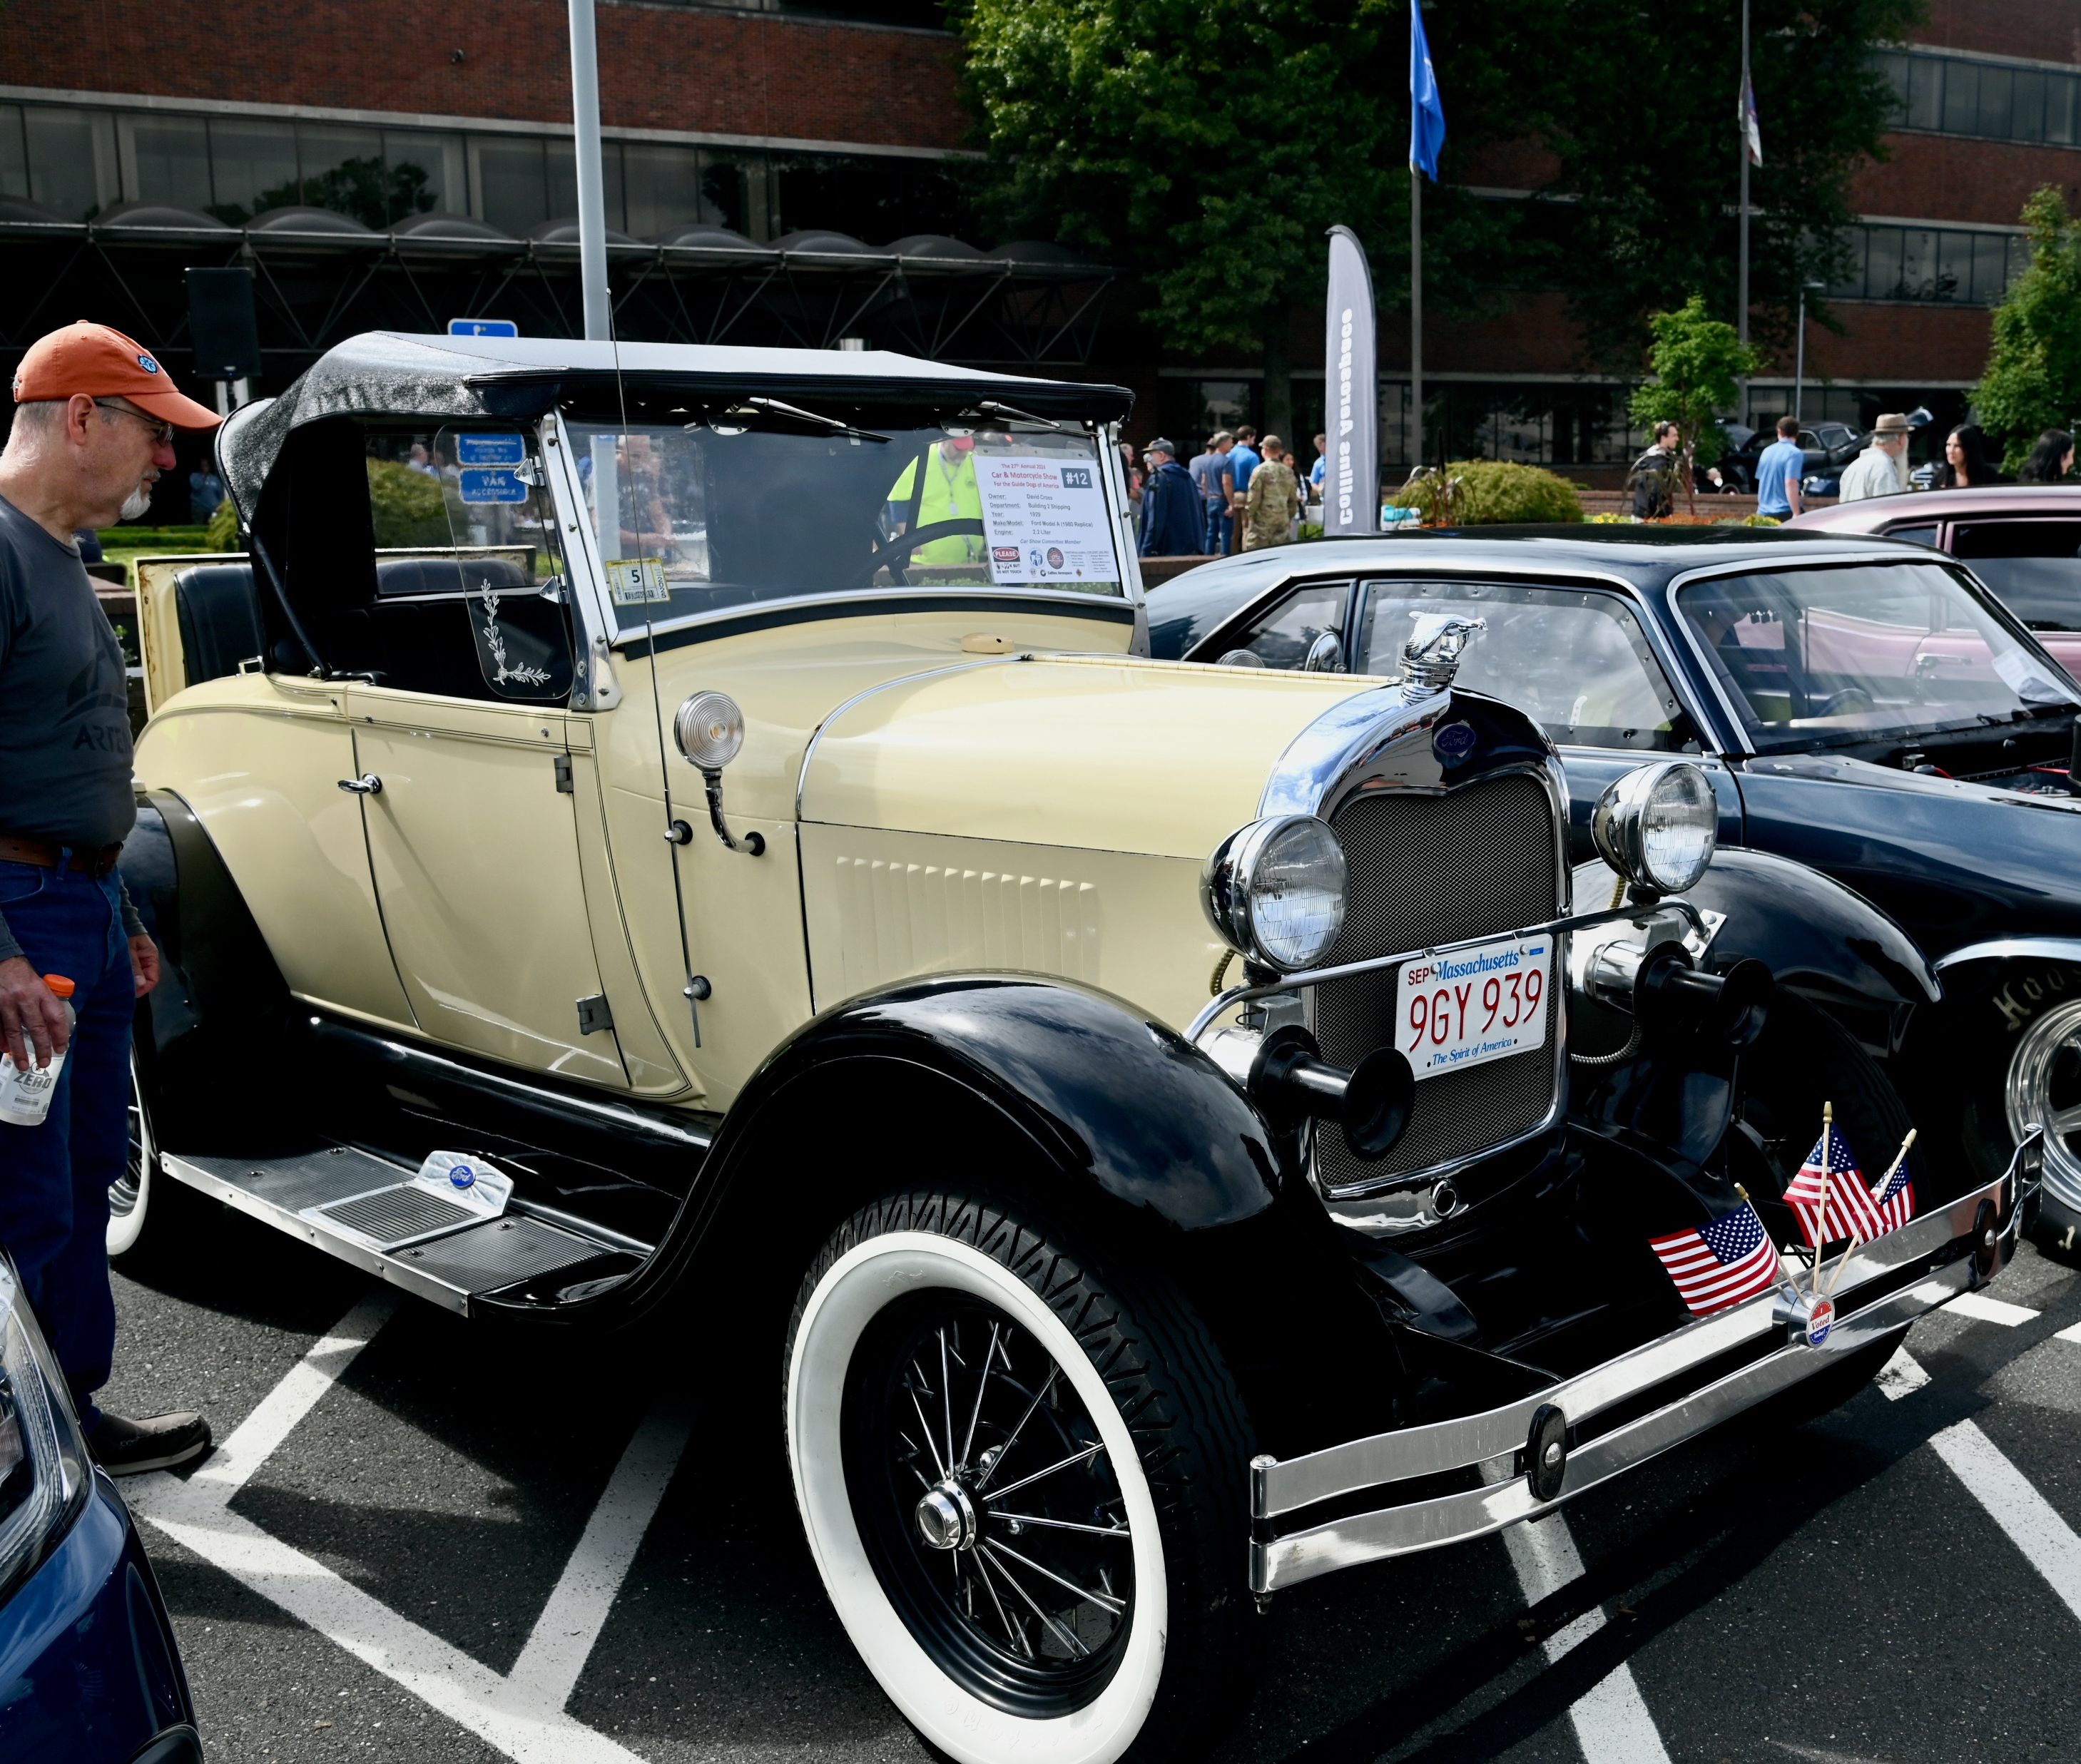
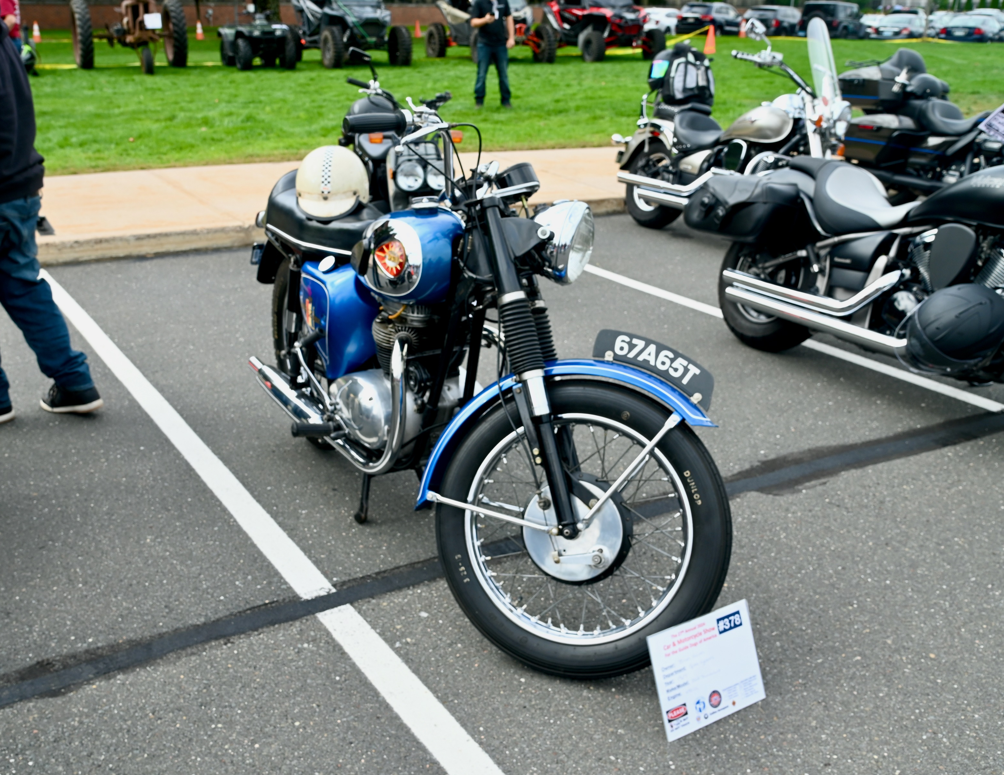

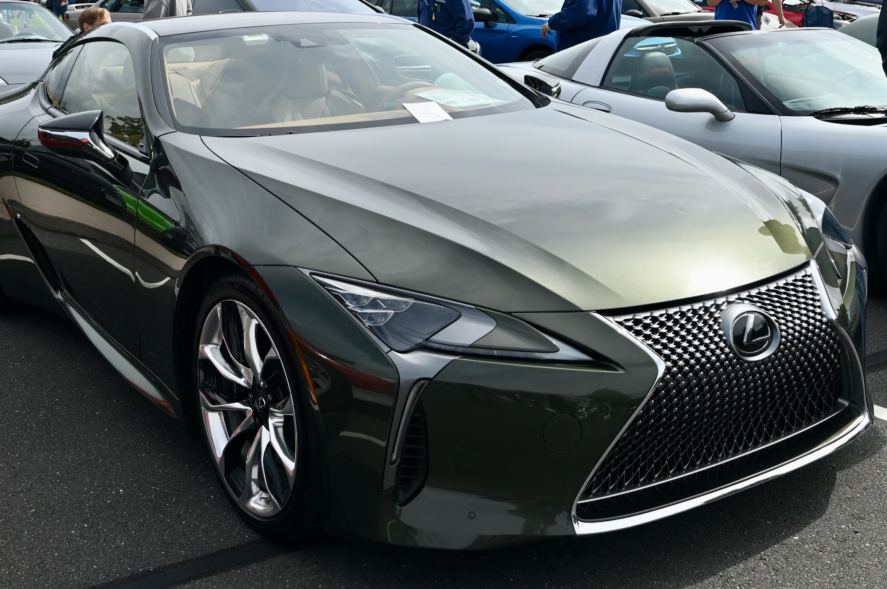
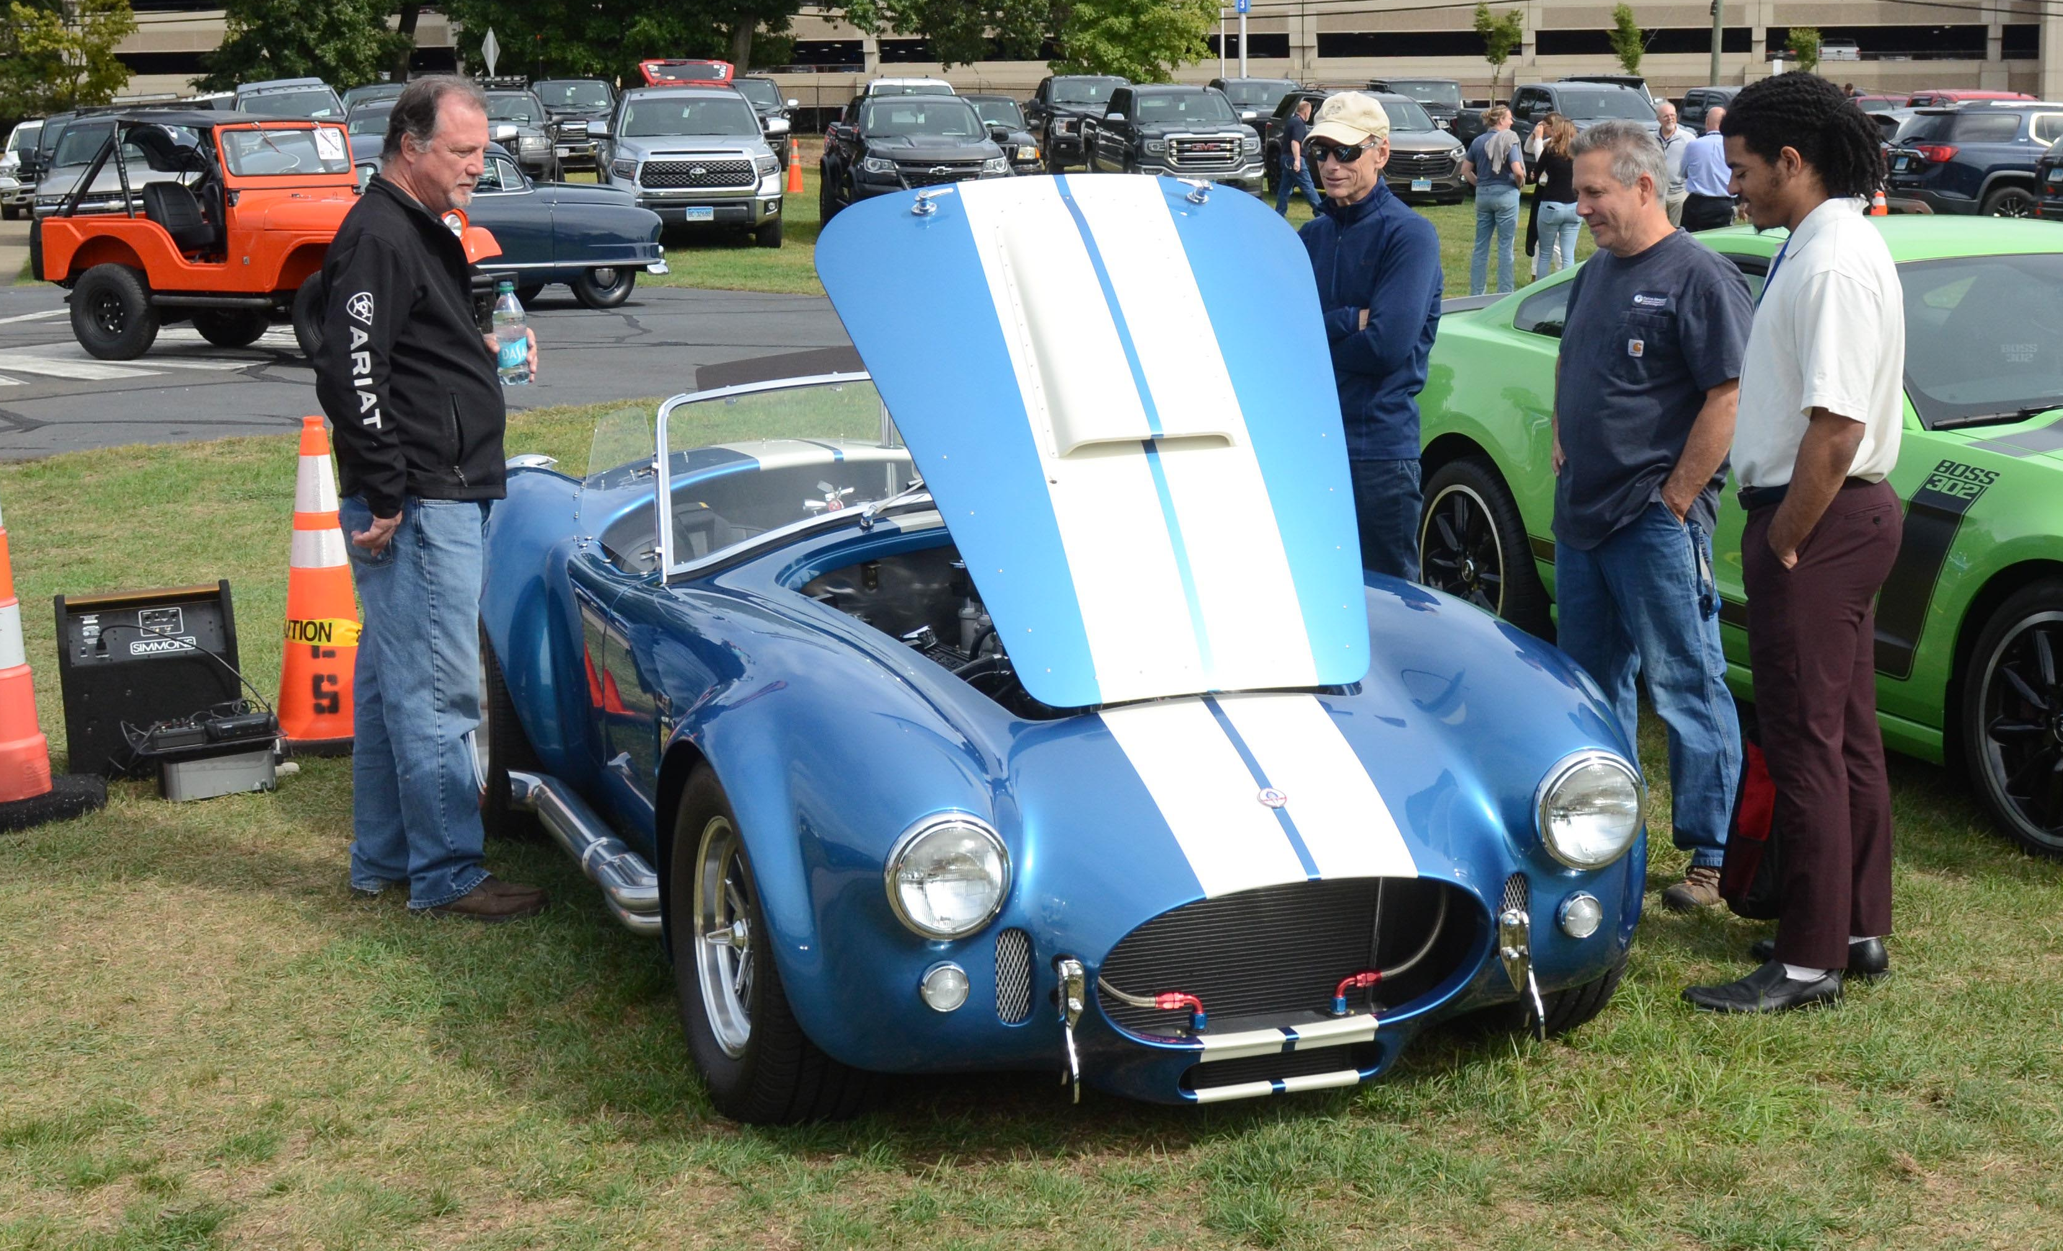




The 28th Annual 2025
Car & Motorcycle Show
For the Guide Dogs of America
Friday, September 19, 2025
11:00 am – 1:00 pm
Horseshoe Parking Lot, Building 1
Rain Date: Monday, September 22, 2025
Cars, Trucks, Motorcycles & More
(Cash Only)
Registration: $25 ($30 day of show)
Register by September 18, 2025
Look for registration forms posted around campus & in WLOX News
Have questions? Contact Todd Ortolani
todd.ortolani@collins.com

